Slide 1
Customer Advocacy & the Customer Experience Survey
General Overview
May 2016

Slide 2


Customer Advocacy
Customer Experience Survey
Determines Net Promoter Score
Manages survey distribution and Walker BI
Responds to all open-ended comments
Customer Complaints
Mobilizes resources to resolve complaints
Participates in accreditation audits
Reporting
Records survey comments and formalized complaints into SharePoint Log
Publishes monthly and quarterly reports for the businesses and regions

Slide 3


Customer Experience Survey (CES) Overview
15 Total Questions
4 Overall
4 Start Up
4 Project Management & Complete
1 Open Ended
2 Invoice
14 Languages
Reporting
Reported through Walker BI website
Filter criteria:
Business Unit
Division
POC Geography
Survey Distribution
Sent using data from R12
For those Divisions excluded from R12, manual process established
1 survey/90 days
No more than 4x’s/year
2015
Invitations 44,505 | Completes 8,028 | Response Rate 18% | Comments 2,430 | % of Responses with Comments¹ 34%
Note 1: The QA Testing survey excludes the open ended question. Therefore, the number of QA Testing survey completes is excluded from the response rate calculation. % of Responses with Comments = 2,430 / 7,176 = .338

Slide 4
CES Methodology
Customers | C&I, CTECH, & Medical Safety invitations sent 7 calendar days after close of project CRS invitations sent immediately after all order lines are closed Individual customer contacts completing multiple projects receive only one survey within 90-days; maximum 4 per year Due to low project volume DAP, Human Factors Engineering, Medical Regulatory, MDT, MRAS/MDRS use a 60 day rule instead
Languages | Invitation email and survey conducted in 1 of 14 local languages:
 | Chinese (Simplified) Chinese (Traditional) Danish Dutch English French (Western European) German | Italian Japanese Korean Portuguese Spanish (Western European) Spanish (Latin America) Swedish
QA Testing | Survey sent to Ship To GL Code = 731, 714, 716, 723, 724, 734, 771, 772, 773, 774, 775, 776, 777, 778
QA Inspection | Survey sent to Sold To GL Code = 732, 733
Responsible Sourcing | Survey sent to Sold To and Bill To GL Code = 752, 753, 754 EXCLUDING Location Code = 772-Stroudsburg, PA
Wireless & EMC Bundled Orders | NA: Randomly select whether the record is assigned to Safety or Wireless & EMC EMEA+LA & Asia: Default to Safety. Record will only be classified as Wireless & EMC if the order only contains Wireless & EMC

Slide 5
Customer Experience Survey
Business Unit | Division | CES Status
Commercial & Industrial | Appliance/HVAC/Lighting/Water Building & Life Safety Technologies DAP Energy & Power Technologies DEWI-OCC Performance Materials TTC IPM Wire & Cable | CES Live
 | Multiple Listing Field Evaluations DEWI GmbH Lightning Protection | Scheduled to go-live Q2 2016 Scheduled to go-live Q2 2016 Scheduled to go-live Q3 2016 Scheduled to go-live Q3 2016
 | Laboratory Testing Services (formerly CITS) Testtech | No current plans to join the CES
Consumer | CTECH QA Inspection QA Testing Responsible Sourcing Small Appliances | CES Live
 | Software and Security Futuremark Registrar | No current plans to join the CES
 | Transaction Security | Scheduled to go-live Q2 2016
= Participates in survey
= Does not participate in survey
= Does not currently participate in survey, but scheduled to join

Slide 6
Customer Experience Survey Cont.
Business Unit | Division | CES Status
Life & Health | Human Factors Engineering MDT Medical Safety Medical Regulatory Solutions (formerly MRAS / MDRS) | CES Live
 | EduNeering | Scheduled to go-live Q3 2016
Supply Chain & Sustainability | Furniture UL Environment WERCSmart | CES Live
 | WERCS Studio | Scheduled to go-live Q2 2016
 | UL Prospector Good Guide | No current plans to join the CES
EHS Sustainability | Former WHS organization | CES Live
= Participates in survey
= Does not participate in survey
= Does not currently participate in survey, but scheduled to join

Slide 7



Net Promoter Score (NPS)
NPS is based on the answer to one question “How likely are you to recommend UL to a colleague or supplier?”
NPS = % Promoters - % Detractors
Fence
Sitters
Detractors
Promoters
0
1
2
3
4
5
6
7
8
9
10
NPS Graphs are posted on the UL Intranet:
http://intranet.ul.com/en/Tools/DeptsServs/OurCustomers/Pages/Home.aspx
NPS benchmark data purchased by a third party company called Satmetrix and contains data from 97 companies in the business services, hardware, manufacturing, software, and telecommunications industries globally.

Slide 8
Walker BI
https://walkerbi.walkerinfo.com/analytics/saw.dll?Dashboard&a=26
Online dashboard for CES results, including NPS
~700 Users
Single-sign-on functionality
Must be on UL network (VPN)
Filter results by Business Unit, Division, POC Region, Customer Country, Global Account, and custom time periods
Users can view Customer Advocacy complaint data and see a summary of verbatim comments and complaints
Survey reporting month ends on the 15th of the following month
If a survey invitation is sent on Nov 30th, customers have 2 weeks to take the survey, until Dec 14th. Therefore, the survey results for Nov will be “frozen” on Dec 15th.
Recorded training session: http://intranet.ul.com/en/Tools/DeptsServs/CommercialOPS/CustomerAdvocacy/PublishingImages/Forms/Thumbnails.aspx

Slide 9
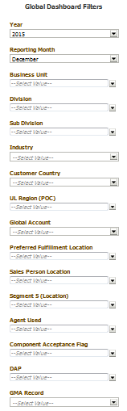
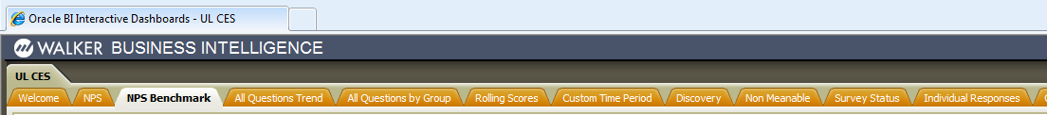
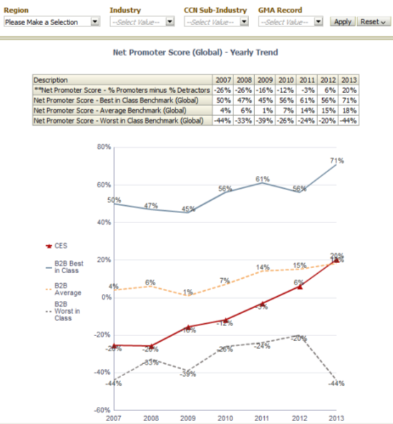
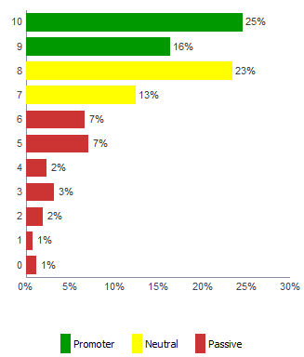
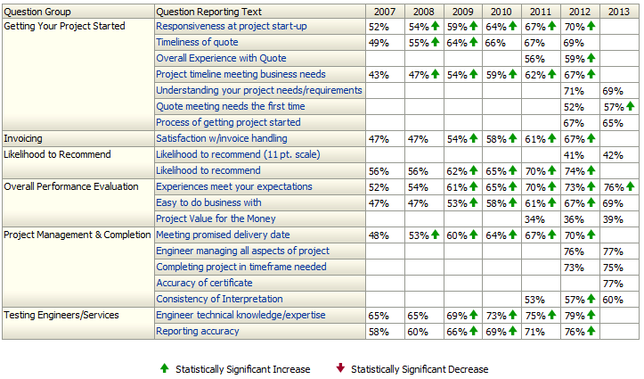
Walker BI

Slide 10
Complaint Handling
Customer Advocacy
Customer Experience Survey
CEC / Local Customer Service
Online Customer Feedback Form
Field Inspectors, Label Center
Customer Advocacy @ul.com
Accounting / Collections
Escalations from Senior Management
Sales
Engineering
Effective June 10, 2013, customer complaints were transitioned from Customer Service to Customer Advocacy
Please submit all complaints to Customer Advocacy via the online Customer Feedback Form: http://intranet.ul.com/collab/CustomerAdvocacy/SitePages/Customer%20Feedback%20Form.aspx
Customer Complaint Handling Fact Sheet
Customer Complaint Handling SOP
CustomerAdvocacy@ul.com

Slide 11
Terry Brady
Alison Johnson
Anita Lynn
NA BLST
NA CTECH
Kim Anderson
NA EPT
NA W&C
NA PM
Manasa Tsappati
ANZ all BUs
ASEAN all BUs
South Asia all BUs
NA QA Testing
NA Transaction Security
Valentina Lecca
EMEA all BUs (except France, Spain, & Portugal)
Shelly Liu
Greater China all BUs
Anne-Lise Stone
NA Small App.
NA LHS
NA AHL/W
NA EduNeering
Andrew Stummer
NA UL Environment
NA Furniture
NA WERCS
NA UL Prospector
Luciene Barros
Brazil & Portugal all BUs
Hiromi Yamaoka
Japan all BUs
Elaine Lee
Korea all BUs
Daniela Gonzalez
LA all BUs
Spain all BUs
France all BUs
NA QA Inspection
NA WHS
NA Responsible Sourcing

Slide 12
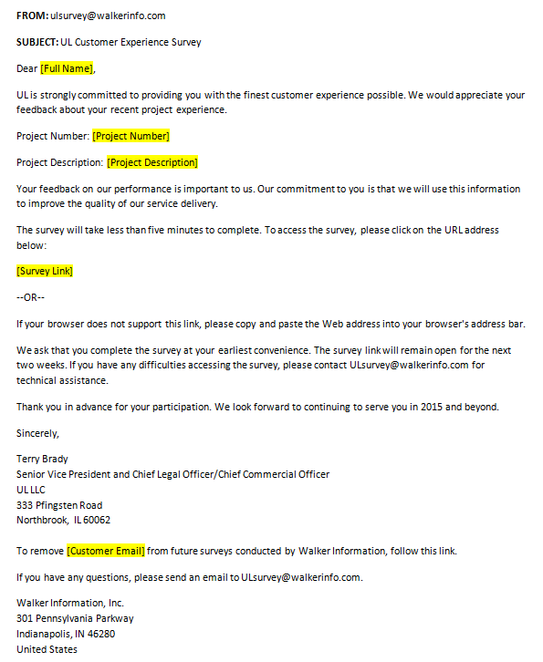
CES Email Invitation

Slide 13
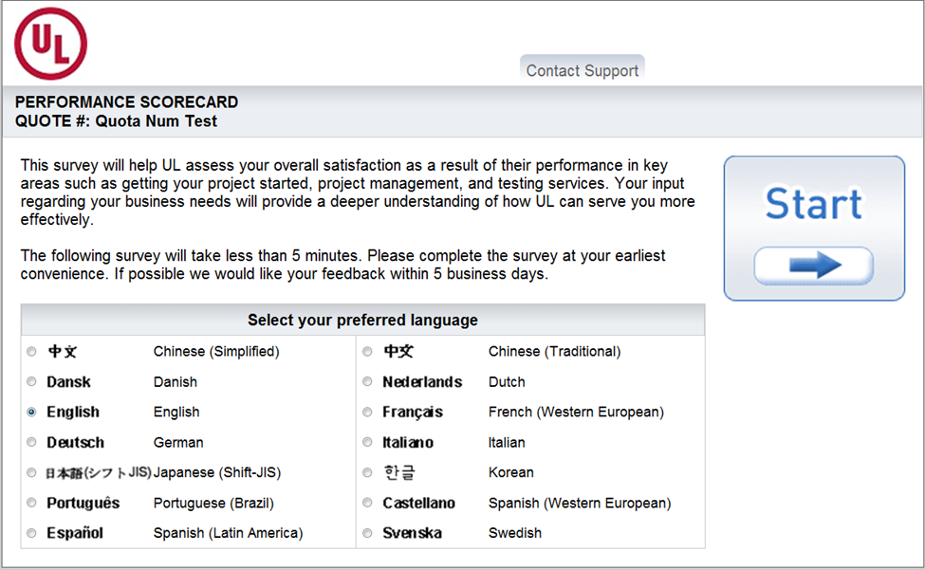
CES - Introduction

Slide 14
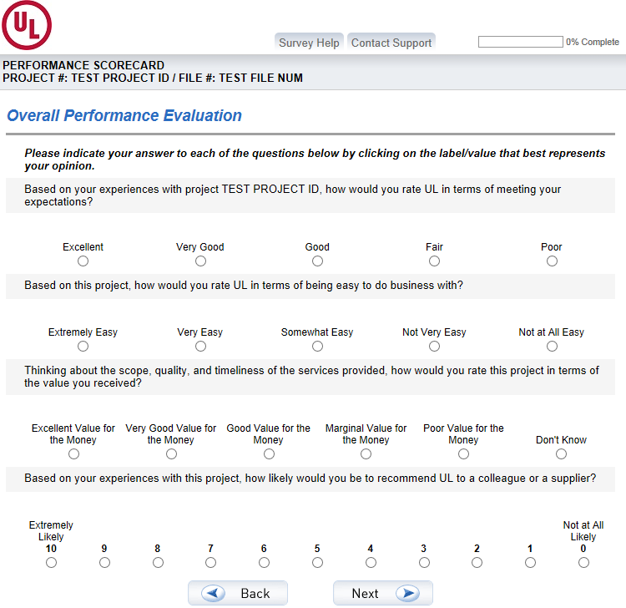
C&I, CTECH, Medical Safety, Furniture CES

Slide 15
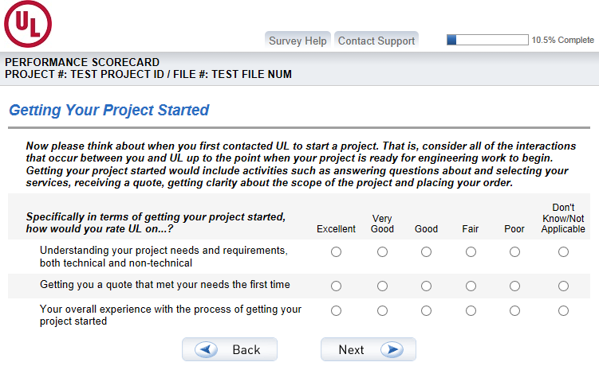
C&I, CTECH, Medical Safety, Furniture CES

Slide 16
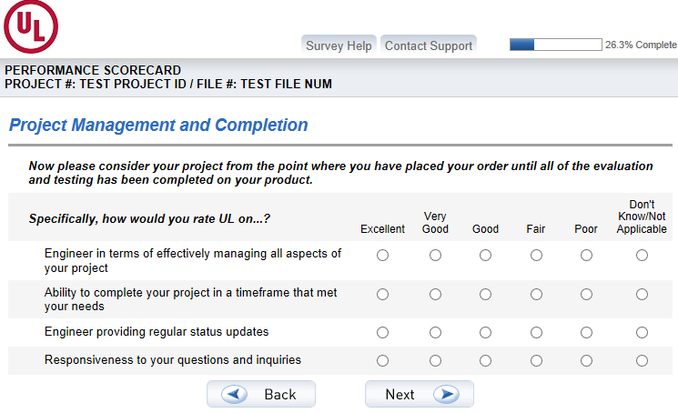
C&I, CTECH, Medical Safety, Furniture CES

Slide 17
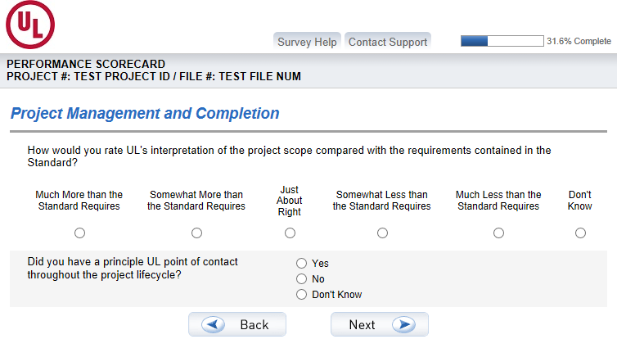
C&I, CTECH, Medical Safety, Furniture CES

Slide 18
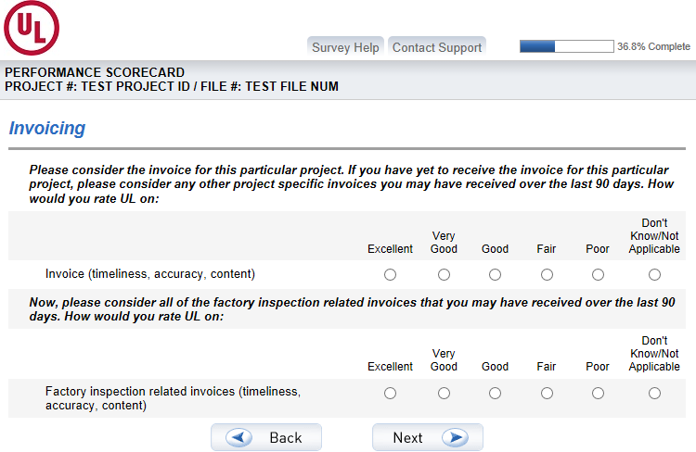
C&I, CTECH, Medical Safety, Furniture CES

Slide 19
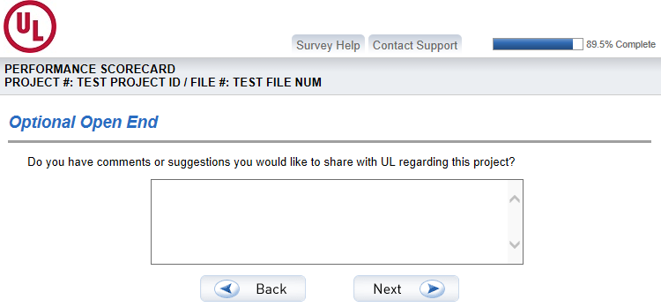
C&I, CTECH, Medical Safety, Furniture CES

Slide 20
Other Versions of the CES
C&I / CTECH / Medical Safety / Furniture / Small Appliances
DAP
DEWI: Inspection Body - IAS Only
DEWI: excluding IAS and DEWI-OCC
DEWI-OCC
EduNeering – Client Services
EduNeering – Learning Services
EduNeering – Strategic Advisory
EduNeering – Technical Advisory
EHS Sustainability - Implementation
EHS Sustainability - eLearning
EHS Sustainability - New Customer
EHS Sustainability - Renewal Customer
EHS Sustainability - Training
EHS Sustainability - Ongoing/General
Field Evaluations
Human Factors Engineering
IPM
Lightning Protection
Medical Device Testing (MDT)
Medical Regulatory
Medical Solutions
Multiple Listing
National Analysis Center
QA Inspection
QA Testing
Responsible Sourcing
TTC
Transaction Security – Product
Transaction Security – Services
Transaction Security - Training
UL Environment
UL Prospector
WERCSmart
WERC Studio

